Slide 1
2023 Annual Meeting
June 7th, 2023

Slide 2
Agenda
5:00 – 6:00 social hour
6:00 – 7:00 Program
Business Meeting
Guest Speakers
Marc Meyer, President/Chair of Francisco Park Conservancy
Celebrating Francisco Park’s one year anniversary
Nancy Botkin of Walk SF
Russian Hill’s famous stairways and alleys
Barbara Bella and Susan Gage, RHN Committee Chairs
Doing our part to reduce plastic waste

Slide 3
Our Committees
Communications
Design, Zoning and Land Use (DZLU)
Families
History
Local Business
Marketing
Membership
Neighborhood Enhancement
Parks
Safety
Social
Transportation

Slide 4
Communications
past yearThi
Monthly Newsletters
We have 1,378 Subscribers, a 3% increase from last year.
60% of these are highly or usually engaged with the content
Our "open rate" is 18% higher than comparable groups
Instagram Activity
We currently have 1,045 followers, including other community groups like North Beach and TelHi. Photos of people participating in our activities tend to be more frequently commented on.
Website
We have focused on uploading more current news items, updates about our activities and neighborhood issues and events which has driven a significant increase in traffic over last year with 12,200 visits. The events page drives has the highest traffic with more visitors coming from the google search engine.
Google Search Initiative
With the goal of raising awareness about RHN, its work and to increase participation in our activities we will soon be launching an awareness campaign.

Slide 5
Design, Zoning and Land Use (DZLU) Committee
Helping to shape projects and land use policies that will benefit Russian Hill and the city
AMONG THIS YEARS HIGHLIGHTS
Replacement in-kind of the deteriorated Macondray Lane entry trellis:
Construction is planned for this summer. The iconic gateway to the Macondray Lane is on the National Register Historic District and also the fabled setting of Armistead Maupin’s Tales of the City.
We were able to make this happen thanks to funds we successfully raised from generous neighbors and devotees, as well as securing a seed grand from RHN.
North Beach Historic Context Statement:
RHN supported adoption by the Historic Preservation Commission of the North Beach Historic Context Statement, prepared by the Northeast San Francisco Conservancy. This resource documents the special beauty and historic significance of several blocks on the east-facing slope of Russian Hill.
Housing Element:
DZLU reviewed draft rezoning proposals and provided input to the Planning Commission. We support increased density along major commercial corridors such as Van Ness Ave. and Polk St., but have raised concerns about increasing heights to 65 feet north of Bay St. near the waterfront and historic properties, and in several smaller-scaled residential neighborhoods east of Polk St.

Slide 6
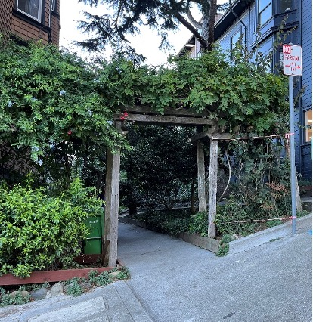
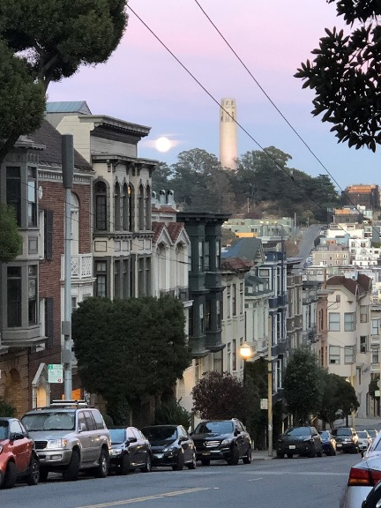
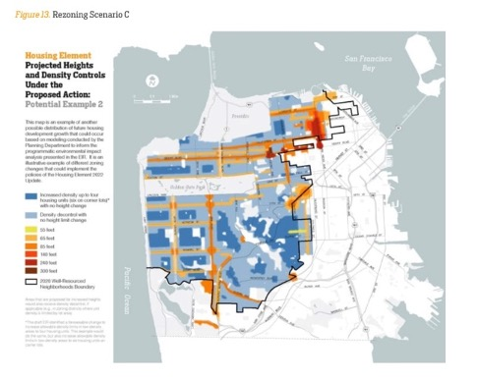
Design, Zoning and Land Use (DZLU) Committee
Replacement in-kind of the
deteriorated Macondray Lane
entry trellis
North Beach Historic
Context Statement
Housing Element
We’re always eager to recruit new DZLU’ers with curiosity about planning, zoning and design! Contact zoning@rhnsf.org

Slide 7
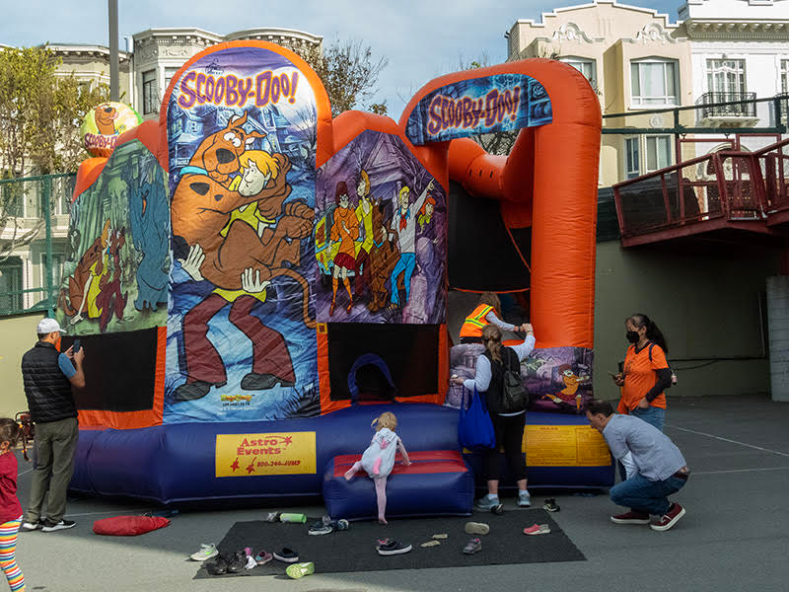
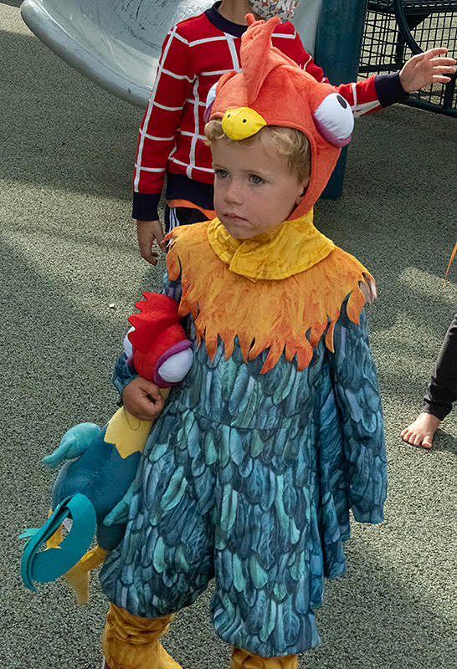
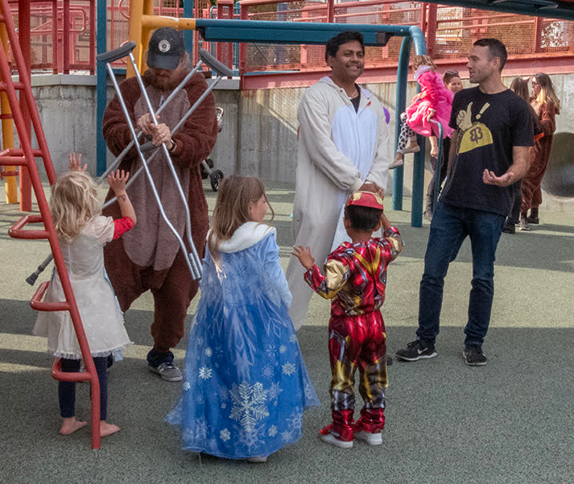
Families
Community Events for Families
New Year’s Meet Up
Halloween Celebration with Polk Businesses
Music in the Park (upcoming)
Celebrating the opening of the new indoor play center (upcoming)
Advocating for Youth
Educational Outcomes
School Safety
Partnering with Local Schools and Businesses
Tel Hi Co-Op
Yick Wo Elementary
More to come….

Slide 8
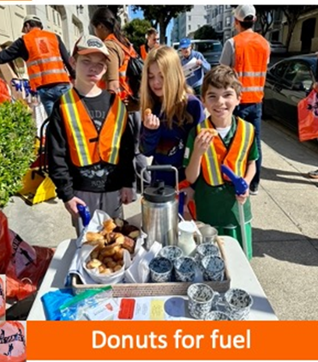
Neighborhood Enhancement
Promote improvement of the physical environment and serve as liaison with city and other government agencies and commissions, foster a neighborhood spirit to improve the quality of life for people who reside and work here and monitor the maintenance and improvement of the city’s infrastructure.
We launched CLEAN UP AND SMILE events; 2nd Saturday every month!
Socialize over Saint Franks coffee and Bob’s donut holes
Clean up
Thank you treats from local merchants: Swensen’s Ice Cream,
Za Pizza, Cheese Plus, Nick’s Crispy Taco, Shanghai Kelly’s, Teaspoon, Fueling Station, Gastrobot Eats.
We promote our events thru RHN, Refuse Refuse and Together SF.
Since Aug 2022, we average 30 volunteers per event with almost 200 participants from around the neighborhood and picked up over 700 bags of trash.

Slide 10
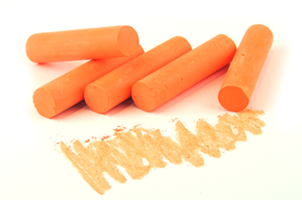
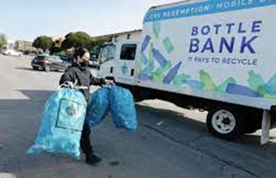
Local and Statewide Initiatives
Mechanical Street Cleaning: Meetings with SFPW to add street cleaning without the requirement of petitions. Pilot launched in May to clean 10 streets/month until permanent solution found.
Doggie Do: Because of too much dog poo on the streets and in planters, we surveyed our community. Dog owners said…”We Need More Trash Cans!”
•We carry orange chalk everywhere and circle doggie do left behind with the word NO!.
•We’ve created a sign What’s Up Dog? transparency for city-wide use if requested.
Trash Cans: We mapped locations of all trash cans. Requested trash receptacles in specific locations with a goal to have a can within 3 blocks of all residents or visitor. 7 of the 15 were approved and installed!
Cigarette Litter: We have teamed-upped with Refuse Refuse and NSAC to advocate for the elimination of toxic cigarette waste. Engaging public officials local and statewide.
Plastic Waste: Utilizing Bottle Bank App to properly recycle plastic and aluminum cans and bottles. https://sfbottlebank.org/create-account/
ACTIONS FOR A CLEANER SF. Check out our first-ever webinar with SFPW, Recology and
Refuse Refuse at

Slide 11
Parks
We received approx $2500.00 in donations of dedicated funding, plants and various supplies to enhance green spaces in the neighborhood
We partnered with Eagle Scouts to plant child friendly, pollinator friendly, shade tolerant, drought tolerant native plants and seeds in Yick Wo Elementary School green spaces.
RHN parks is advocating with SFRPD to extend our pollinator corridor into the Marina Green
upgrade from from Francisco Park and NPS Black Point Gardens across to NPS Quartermaster’s Reach and the Presidio. Butterfly caterpillars co-evolved with local native plants.
Our monthly park events to remove invasive plants, weeds and debris from green spaces in the neighborhood continue to be well attended. We are grateful to the dedicated group helping to beautify our parks.
Thanks to a generous donation we had access to restricted funds which allowed us to turn 4 existing empty street treewells on the 1800 block of Hyde street into sidewalk gardens with low fencing and durable, colorful, drought tolerant evergreen native plants.

Slide 12
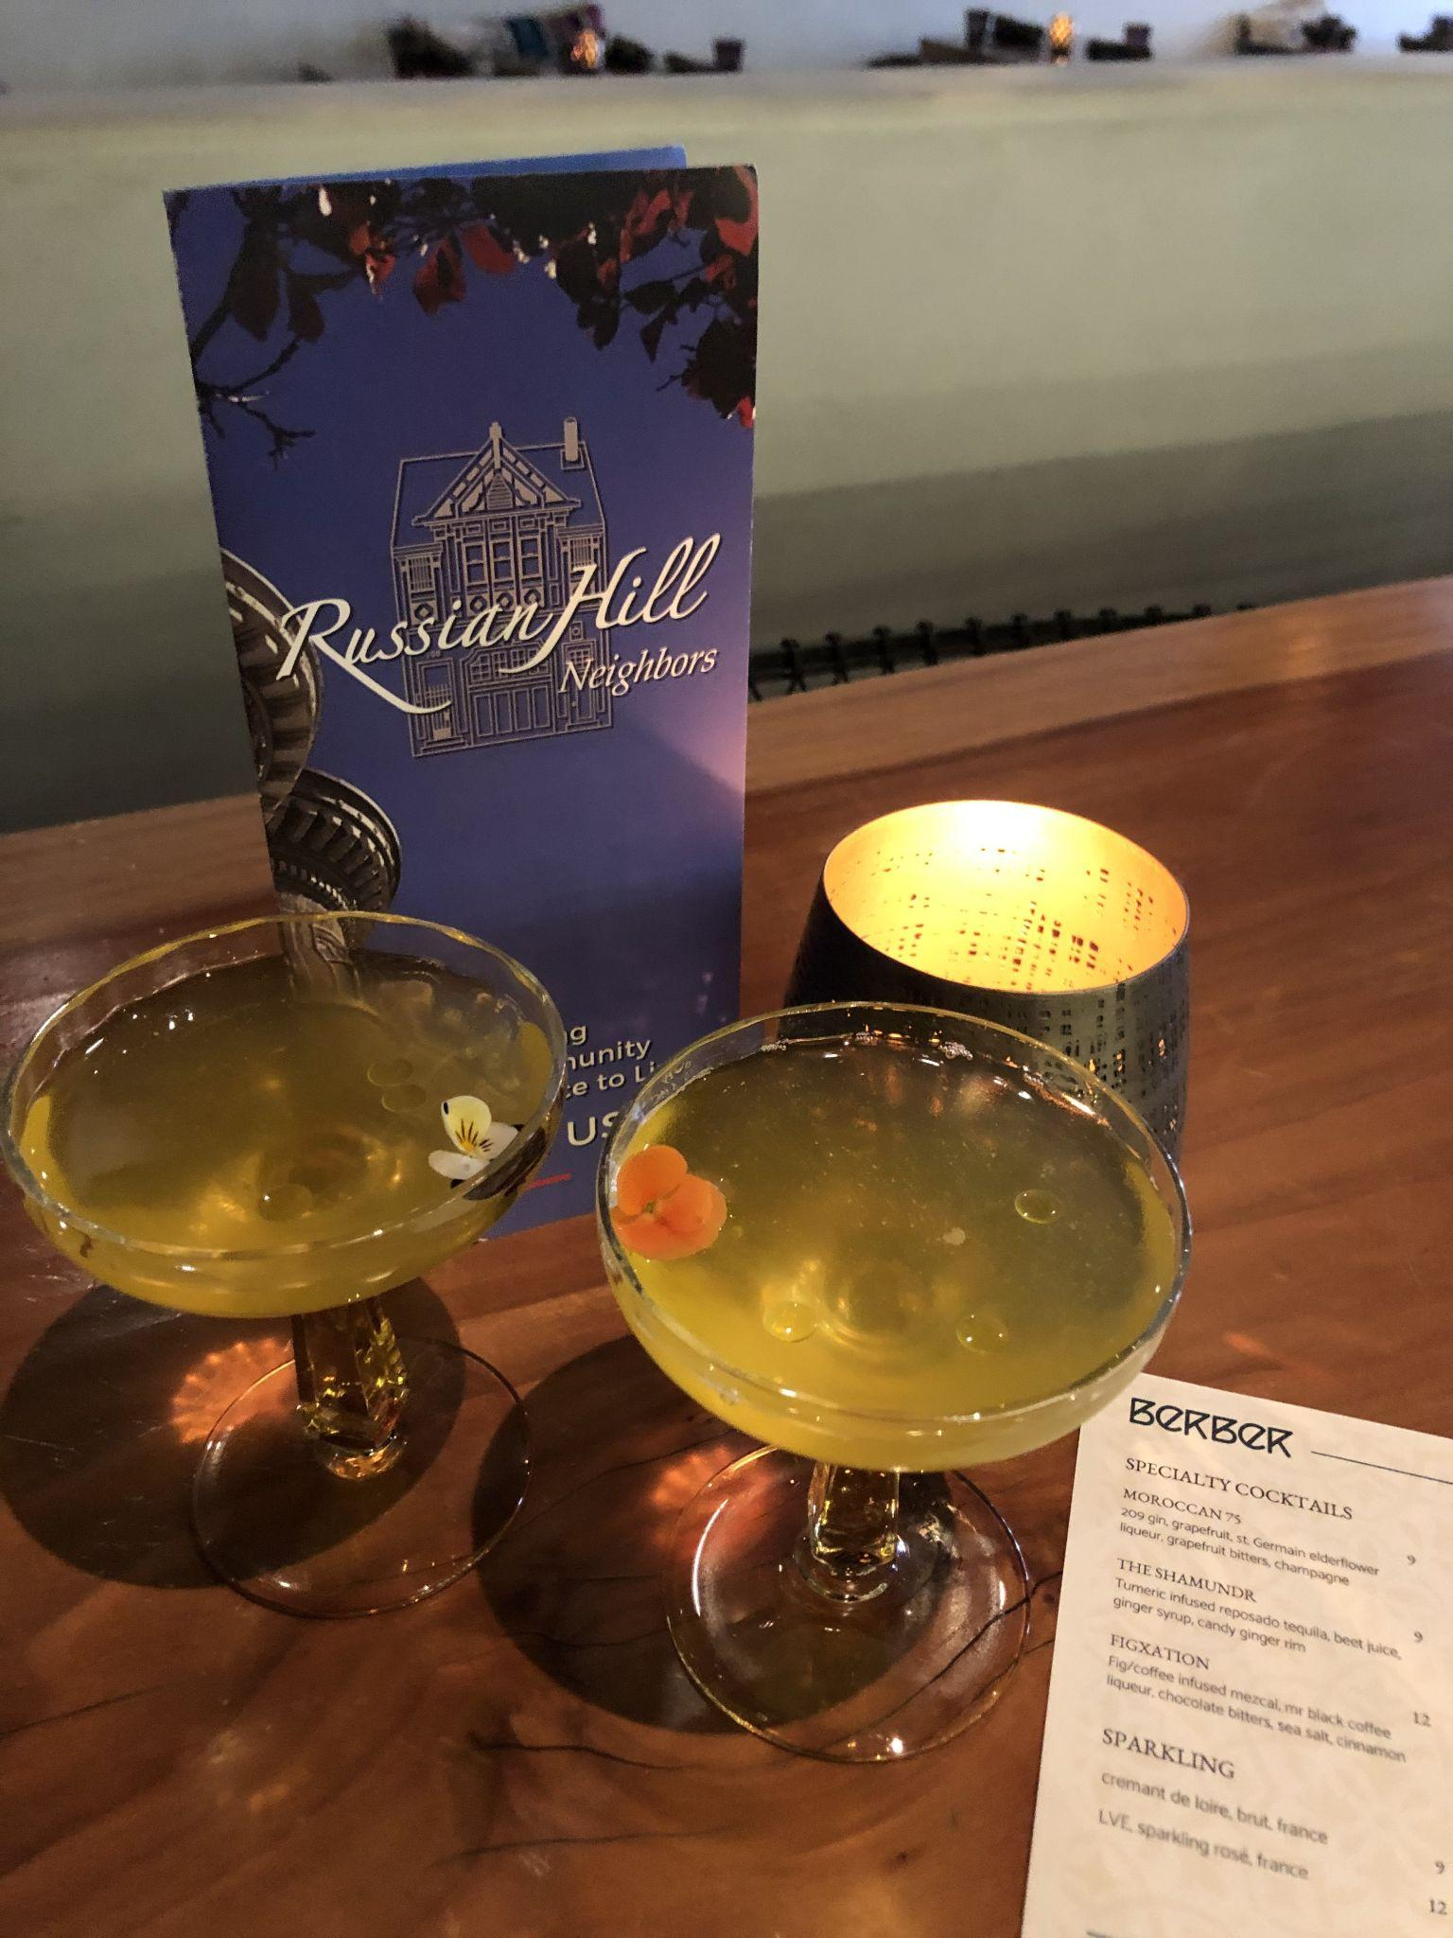
Social
jk
RHN has been busy getting social. We hosted several Cheers! happy hours at merchant members and other businesses in the community.
Upcoming Events:
June 11: Historical walking tour
June 13: Salon discussion group
June 16: Cheers! at a new merchant
July 14: Cheers! at a new merchant
Sept 9: Summer picnic
September 23: Symphony outing
December: Holiday party
... and much more to come!

Slide 13
Treasurer’s Report – RHN Fiscal Year Comparison
INCOME | May 2022 - April 2023 | May 2021 - April 2022
Membership Income | 11,330 | 12,013
Donations to RHN | 3,712 | 5,634
Misc | 20 | 21
Total Income | 15,062 | 17,670
EXPENSES
Committees | 8,107 | 3,303
Donations From RHN | 9,795 | 4,900
General Overhead | 2,547 | 4,118
Total Expenses | 20,450 | 12,321
NET INCOME | -5,388 | 5,349
Total Assets | 109,037 | 104,505
Restricted Funds | 33,397 | 23,478
Non-Restricted Funds | 75,640 | 81,027

Slide 14
Your Money At Work
Donations and sponsorships we made this year
Francisco Park Conservancy
League of Women Voters
Macondray Lane Entrance Structure
National Night Out
NEXT Village
North Beach Citizens
Spoolk Street Spooktacular Halloween Event
Telegraph Hill Neighborhood Center
Vallejo Stairway Garden
Yick Wo Elementary School

Slide 15
RHN Board Members
Executive Committee
Carol Ann Rogers, President
Pamela Meyers, Vice President
Greg Carr, Vice President
Suzee Barrabee, Secretary
Joyce Kucharvy, Treasurer
Tina Moylan, Past President
Richard Cardello, At Large
Directors
Robert Bluhm (to 2023)
Alice Alioto (to 2023)
Greg Polchow (to 2023)
Richard Cardello (to 2024)
Stephanie Falkenstein (to 2024)
Phoebe Douglass (to 2024)
Advisors
Lucretia Rauh, Chair
Tim Covington
Jovanne Reilly
Judy Junghans
Committee Chairs
Susan Ford, Communications
Matthew Mansfield, Liaison to Neighborhood Coalitions
Stephanie Falkenstein, Families
Al Greening, History
Moe Jamil, Local Business
Danny Wolner, Marketing
Kris Anderson, Membership
Barbara Bella & Susan Gage, Neighborhood Enhancement
Susan Karasoff, Parks
Mike Saah, Safety
Michelle Montoya, Social
Steve Taber, Transportation
Robert Bluhm, Zoning (DZLU)

Slide 16
Slate of Officers for Voting
Election of Officers and Directors*
Officers for 2023-2024
Carol Ann Rogers, President
Pamela Meyers, Vice President
Gregg Carr, Vice President
Joyce Kucharvy, Treasurer
Suzee Barrabee, Secretary
Nominated Board Members, 2023-2025
Adam Barrett
Robert Bluhm
Alice Alioto
Greg Polchow
Returning Board Members, 2022-2024
Richard Cardello Stephanie Falkenstein
Phoebe Douglass
*by Voice Vote of Membership

Slide 17
Our Mission
Russian Hill Neighbors (RHN) is a voice for residents and merchants to preserve and advance neighborhood character and quality of life through collaboration, volunteerism, and celebration of community.
Thank you for being an RHN Member

